Slide 1
Confusion Matrix
06 - Intro to ML
Confusion Matrix (CM)

Slide 2
Course Overview:
1.1 - Python Review
1.2 - Numpy
1.3 - Pandas
1.4 - Seaborn
2.1 - ML Intro
2.2 - Linear Regression
2.3 - Logistic Regression
2.4 -Naïve Bayes Classifier
2.5 - KNN
2.6 - Decision Trees
3.1 – Ensembling Learning
3.2 - Neural Networks
4.* - Natural Language Processing (NLP)
5.* Competition Tips & Final Thoughts

Slide 3
CM for Spam Filter
Reminder: ML is taken from intelligent agents.
ML algorithm (MLA) is a software agent.
Spam filter is based on ML model, the goal is to minimize the cost of erroneous decisions in the long term; E.g., a spam filter is an agent that puts incoming emails into wanted or unwanted (spam) categories & deletes any unwanted emails. Its goal as a goal-based software agent is to put all emails in the right category. In the course of this not-so- simple task, the agent can occasionally make mistakes. Because its goal is to classify all emails correctly, it will attempt to make as few errors as possible. However, that is not always what the user has in mind. Let us compare the following two agents. Out of 1,000 emails, Agent 1 (or MLA 1) makes only 12 errors. Agent 2 (MLA 2) on the other hand makes 38 errors with the same 1,000 emails. Is it therefore worse than Agent 1? The errors of both agents are shown in more detail in the following confusion matrix:

Slide 4
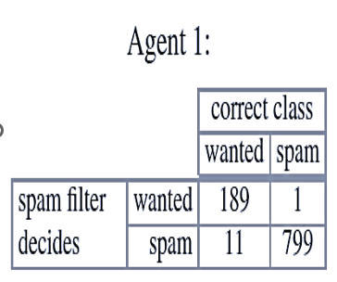
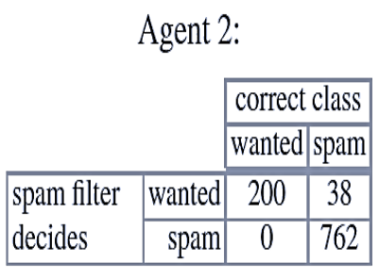
CM for Spam Filter
Types of Errors (due to miss classification):
Spam but not classified as spam, aka False positive (Fn) → (Fp)
Email which wrongly classified as spam (severity), aka False negative (Fp) → Fn
Tp
Fp
190
810
238
762
200 800
1000
200 800
Note: The total number of observations is 1000, 200 are not spam (wanted).
Fn
Tn

Slide 5
Goal-based Agents versus Cost-based Agents - cont
Types of Errors (due to miss classification):
Spam but not classified as spam, aka False positive (Fn) → (Fp)
Email which wrongly classified as spam (severity), aka False negative (Fp) → Fn
Tp
Fp
190
810
238
762
200 800
1000
200 800
Note: The total number of observations is 1000, 200 are not spam (wanted).
Fn
Tn

Slide 6
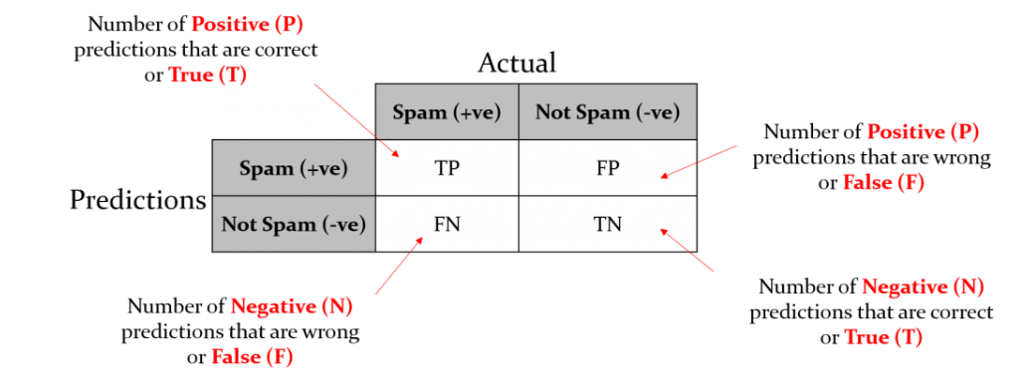
Confusion Matrix for Spam Filter
Note: We need to identify our primary target (favorable) as positive and others (unfavorable) as negative.

Slide 7
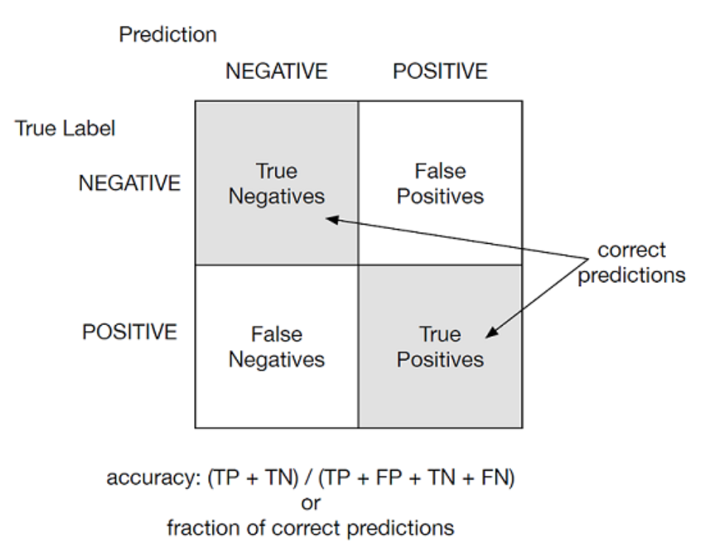
Reshape the Confusion Matrix

Slide 8
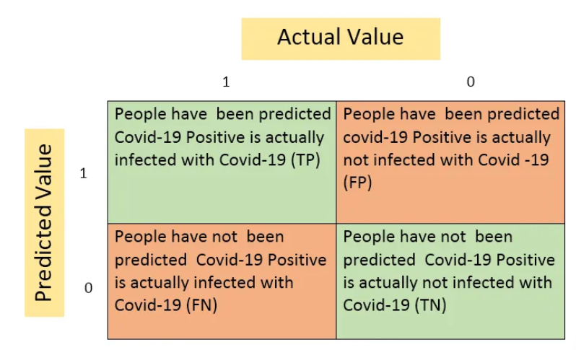
Confusion Matrix for Corona Test Kit
Example: Suppose that your company has developed Covid-19 testing kit. To check the validity of this kit company has randomly taken 100 covid-19 suspect out of which 60 people were infected with covid-19 and 40 people had shown negative result. But your kit was able to detect only 20 covid-19 infected people. Let’s make confusion matrix based on this example:
Notes:
https://medium.com/analytics-vidhya/confusion-matrix-wont-confuse-you-anymore-90424c1bdba9

Slide 9
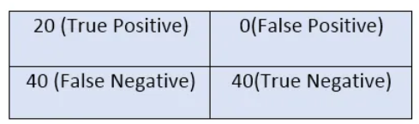
Confusion Matrix for Corona Test Kit
Example: Suppose that your company has developed Covid-19 testing kit. To check the validity of this kit company has randomly taken 100 covid-19 suspect out of which 60 people were infected with covid-19 and 40 people had shown negative result. But your kit was able to detect only 20 covid-19 infected people. Let’s make confusion matrix based on this example:
i. True Positive(TP) :- Predicted Yes and They do have the disease.
ii. False Positive (FP):- Predicted Yes but They don’t have the disease.
iii. False Negative (FN):-Predicted No but they do have the disease.
iv. True Negative (TN):- Predicted No and they don’t have the disease.
Notes:
https://medium.com/analytics-vidhya/confusion-matrix-wont-confuse-you-anymore-90424c1bdba9

Slide 10
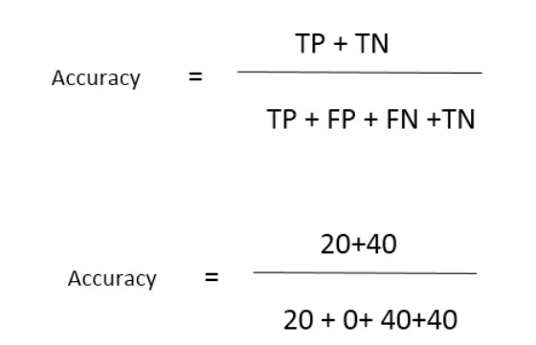
Evaluation Metrics
Let’s Understand some more parameter that might be helpful for the evaluation of binary clasification model.
Accuracy
It is the ratio of total number of correct classifications to the total number of classifications.
Notes:
https://medium.com/analytics-vidhya/confusion-matrix-wont-confuse-you-anymore-90424c1bdba9

Slide 11
Evaluation Metrics
The remaining “Evaluation Metrics“ will be covered latter on.
2. Recall / Sensitivity
3. Precision
4. F1 Score
Notes:
https://medium.com/analytics-vidhya/confusion-matrix-wont-confuse-you-anymore-90424c1bdba9

